Slide 1
Medications and Monitoring to Leverage Long-term Recovery
Greg Skipper, MD
Promises Professionals Treatment Program
Santa Monica, CA
www.professionalstreatment.com
www.professionalsevaluations.com
gskipper@promises.com
310-633-4595

Slide 2
Focus of Research in the USA
New Medications
New Medications
New Medications

Slide 3
Traditional Abstinence Based Recovery
2011 – Proposal for a study of physician health programs by the most prominent epidemiologist in the United States, Linda Cotler, was denied. Reason: “It has been well established that abstinence is an inappropriate goal for treatment of addiction.”
APA meeting 2013 – Speaker re Suboxone study comparing various treatment groups:
“…unethical to have an abstinence based arm of the study because abstinence does not work”

Slide 4
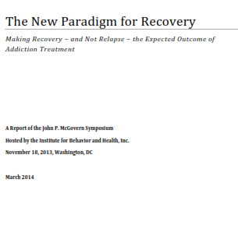
A New Paradigm for Recovery

Slide 5
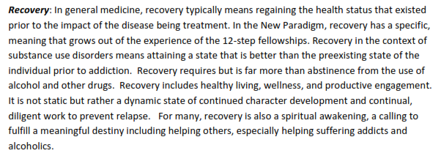

Slide 6
The New Paradigm for Recovery
Treating addiction as a chronic disease
A system of long-term care management
“The shift in focus from episodes of treatment to long-term care management is important.”

Slide 7
Professional Health Programs
Evolved since the 1970’s
Focus on public safety – i.e. assurance of sobriety of the professional
Thorough evaluation
Adequate initial treatment
Ongoing treatment and monitoring x 5 years or more
MD’s and other health professionals, Pilots, Attorneys

Slide 8
Treatment Centers
Specialized programs evolved to deliver evaluations and patient oriented (as opposed to program oriented) treatment
Talbott Recovery Center – Atlanta
Ridgeview, MARR, U of F, Pinegrove, COPAC, Farley Center, Marworth, Springbrook,
BFC, Hazelden – traditional 28 day programs now adapting to provide professional services
Promises and others

Slide 9
Professional Health Programs (PHPs)
Professional Health Programs – the “clinical arm” of the regulatory board
Physician Health Programs - FSPHP
Lawyer Assistance Programs – CoLAP
HIMS - Human Intervention Motivation Study – started by ALPA

Slide 10
The Role of PHPs
Education and Information
Intervention services
Referral to appropriate evaluation and treatment programs
Monitoring – contracts and monitoring procedures
Report deficiencies
Advocacy

Slide 11
Are there similar programs for non-professionals?
Pain management drug test monitoring
Drug testing for courts, probation, etc.
EAP programs
Parents encouraged to test their children
Post addiction treatment monitoring
ASAM policy statement: “Urine drug testing is a key diagnostic and therapeutic tool that is useful for patient care and in monitoring of the ongoing status of a person who has been treated for addiction.”

Slide 12
Are there similar programs non-professionals?
Post addiction treatment monitoring
Some treatment centers encourage monitoring and provide some services – frequently without a leveraged contingency agreement
Companies providing PHP-Like Care Management (PLCM) services are few
Southworth Associates
Post Treatment Supervision – Dr. Sucher et al
www.ProfessionalMonitoring.com
www.hiredpower.com

Slide 13
Contingency Monitoring
Needs to begin as soon as possible following admission for primary treatment
Identify leverage –
Families - privileges, trust funds
Workplaces – condition of continued employment
Develop contract
Engage PLCM company
Implement program

Slide 14
Contingency Agreement
Duration
Primary care physician
Report (in advance) if any addictive drugs may be needed
Type of monitoring: Soberlink, drug testing, urine, hair, nails
Who gets reports
Contingencies

Slide 15
Conduct monitoring (including customer svc),
TPA - Typically involves software that provides alerts regarding missed check-ins, failure to test, positive test results, etc.
MRO functions
Examples: Affinity, FirstLab, Recovery Trek, Compass Vision

Slide 16
Structure
PHPs
Most are non-profit organizations – either under their own 501(c)3 designations or under a medical association or society or directly under a regulatory board
Few are “for profit”
Funding is increasingly coming from charges directly to participants

Slide 17
PHP Budgets
PHP Budgets - 2005
$409,895 per year average
$270,000 per year median
$21,250 - $1,500,000 Range
Cost per licensee (Total PHP costs only/ does not include treatment costs)
$23.04 Average
$20.53 Median
$4.33 - $71.44 Range

Slide 18
PHP Sources of funding
Other includes: grants, donations, labs, universities, etc
N = 39 programs responding

Slide 19
PLCM Sources of funding
Participant fees
Included in treatment costs
Up front treatment option – e.g. the Caron Foundation
Monthly fee

Slide 20
PLCM Fees
Depend on range of services
Drug testing alone
$1,500 - $3,500 per year
With “coaching” etc. can be much more
With family component – higher cost

Slide 21
Overall Outcomes - Completions
Physicians consecutively enrolled into 16 state physician health programs (n=904)
Transferred or moved and lost to follow-up (n=102):
Transferred in good standing (n=78) and
Left care with no apparent referral (n=24)
Followed 5 or more years (n=802)
19% Failed to complete contract (n-155):
Retired (n=85)
License revoked (n=48) or
Died (n=22; 6 suicides)
64% Completed contract (n=515):
Not monitoring (n=448)
Voluntarily continued monitoring (n=67)
16% Extended contract (n=132):
Relapse(s) resulted in further treatment and monitoring

Slide 22
Outcomes - Licensure Status
License Status | At Date of Signing % (n=802) | Most Recently % (n=802)
Active | 75 | 72
Inactive | 2 | 3
Retired | 0.2 | 2
Probation or other action but licensed with restrictions and able to practice | 8 | 5
Revoked (no license) | 0.2 | 4

Slide 23
Outcomes – relapses, patient harm
Relapses | (n=904) %
Relapse “behavior” without illicit drug or alcohol use (i.e., dishonesty, failing to attend meetings, angry outbursts, etc. | 15
b. Relapse with illicit drug or alcohol use outside the context of active medical practice, on call duties, etc. | 16
c. Relapse with illicit drug or alcohol use directly affecting or potentially affecting medical practice (i.e., at work, on call, and/or unable to report to work) | 5
d. Specific identified harm done to a patient because of relapse (noted in record) | 0.1

Slide 24
Long-Term PHP Drug Test Results

Slide 25
New Paradigm in the CJS
Hawaii’s Opportunity Probation with Enforcement (HOPE) and South Dakota’s 24/7 Sobriety Project
These programs uphold the zero tolerance standard through drug tests and immediate, brief, incarceration for any use
Treatment is available but only required for individuals who demonstrate the need, using “Behavioral Triage”
12-Step participation is optional but encouraged

Slide 26
HOPE Probation
Program began in 2004 in Honolulu under Judge Steven S. Alm, aimed to reduce crime and drug use among offenders
In 2011, HOPE included more than 1,700 participants
HOPE probationers have the most serious drug and crime problems and have been identified as likely to violate their conditions of community supervision
HOPE uses intensive random drug testing for up to 6 years
Every single violation of probation (drug use, missed probation appointments, etc.) leads to immediate – but brief – incarceration
(Hawken & Kleiman, 2009)

Slide 27
Randomized Control Trial of HOPE vs. Standard Probation
Probation officers identified 507 men and women on probation at elevated risk of violating probation conditions
493 eligible for participation in study
Randomly assigned 330 probationers (2/3 of group) into HOPE; 163 control continued with probation-as-usual
Randomization ensured no demographic differences between study groups
Baseline data showed higher-risk (based on recent drug use and missed appointments) probationers were assigned to HOPE
(Hawken & Kleiman, 2009)

Slide 28
Results: HOPE vs. Standard Probation
(Hawken & Kleiman, 2009)
In one-year period, HOPE probationers were:
55% less likely to be arrested for a new crime
72% less likely to use drugs
61% less likely to skip appointments with their supervisory officer
53% less likely to have their probation revoked
HOPE probationers were sentenced to, on average, 48% fewer days of incarceration than the control group

Slide 29
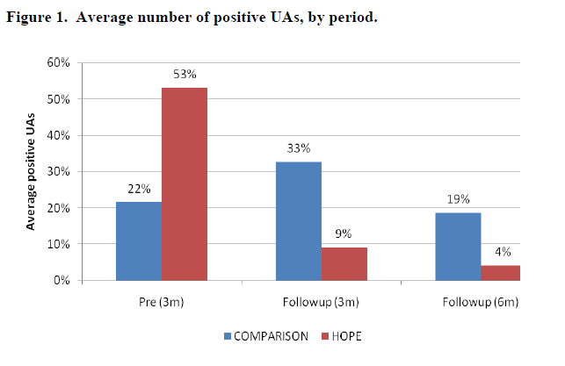
Drug Test Results
(Hawken & Kleiman, 2009)

Slide 30
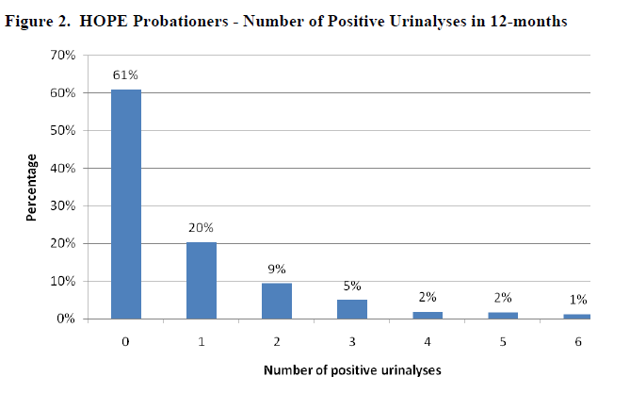
Drug Test Results
(Hawken & Kleiman, 2009)

Slide 31
Number of Positive Drug Tests
Over the course of one year:
61% of all HOPE participants never had a single positive drug test
20% had only one
9% had two
10% had three or more
(Hawken & Kleiman, 2009)

Slide 32
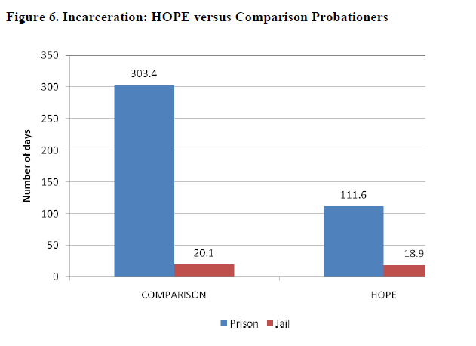
Number of Prison Days Sentenced
(Hawken & Kleiman, 2009)

Slide 33
South Dakota’s 24/7 Sobriety Project
From FY 1999-2010, Driving Under the Influence (DUI) felonies were 36.7% of all felony convictions in South Dakota
From FY 1999-2010, controlled substance felonies totaled 50.9%
From FY 2006-2008, 72% of men and 66% women in South Dakota penitentiary were alcohol dependent
Focus on DUI felons; 48% of 24/7 Sobriety Program participants have 3 or more DUI offenses
(South Dakota Office of the Attorney General, 2012)

Slide 34
24/7 Sobriety Testing & Results
Twice daily alcohol breath tests (7 AM & 7 PM)
SCRAM alcohol monitoring ankle bracelets
Drug urinalysis
Drug patch
Every positive test results in an immediate short-term stay in jail
DUI recidivism substantially lower among 24/7 participants at 1, 2, and 3 years from program completion
(Loudenberg, 2007; South Dakota Office of the Attorney General, 2012)

Slide 35
Overall 24/7 Sobriety Results
Over the average 111 days of participation:
55% never fail a test
17% fail only one test
12% fail only twice
16% fail three or more times
(South Dakota Office of the Attorney General, 2012)

Slide 36
24/7 Alcohol Testing Results: February 2005 – December 2011
20,483 Participants
4.39 million tests administered
Pass Rate 99.3%
(South Dakota Office of the Attorney General, 2012)

Slide 37
24/7 SCRAM Monitoring Results: November 2006 – December 2011
3,659 participants
524,516 total days monitored
77.2% fully compliant participants
337 confirmed drinking events
1185 confirmed tampers
(South Dakota Office of the Attorney General, 2012)

Slide 38
24/7 Drug Urinalysis Results: July 2007 – December 2011
2,153 participants
52,809 number of tests administered
Pass Rate 96.9%
(South Dakota Office of the Attorney General, 2012)

Slide 39
24/7 Drug Patch Results: July 2007 – December 2011
109 participants
1,179 number of tests administered
Pass Rate 86.6%
(South Dakota Office of the Attorney General, 2012)

Slide 40
Summary of Findings
Zero tolerance with swift, certain, and meaningful consequences for any use of alcohol and other drugs – contrary to reasonable assumptions – leads to lower rates of use, higher rates of long-term success, and lower rates of failure
PHPs produced impressive results previously unseen
HOPE and 24/7 Sobriety programs produced lower rates of new crimes and lower rates of incarceration
Use of new concept of Behavioral Triage – treatment is reserved for those who need it to stay clean and sober and for those who choose it

Slide 41
Why Are These Programs Different?
Old Paradigm of care management:
Infrequent or no testing; when testing occurs in treatment it is scheduled
Responses are long-delayed and unpredictable – to missed visits, missed tests, and positive tests
Virtually all treatment is short-term (30 days, a few months, or maybe a year) while the substance use disorders are lifetime disorders
The 12-step programs are underused or not used at all in many current treatment programs

Slide 42
Orientation of New Paradigm
Focuses on long-term, life-long recovery and uses the 12-step programs to overcome the character disorders common to substance use disorders
Uses intensive random testing to enforce zero tolerance for any alcohol or drug use
Any violation is met immediately with known, serious, but brief, consequences

Slide 43
References
Caulkins, J. P. & DuPont, R. L. (2010). Is 24/7 Sobriety a good goal for repeat driving under the influence (DUI) offenders? [Editorial]. Addiction, 105, 575-577.
DuPont, R.L. (2009). Blueprint for lasting recovery: Physician health programs drug test results. Unpublished manuscript.
DuPont, R. L., & Humphreys, K. (2011). A new paradigm for long-term recovery. Substance Abuse, 32(1), 1-6.
DuPont, R. L., McLellan, A. T., Carr, G., Gendel, M., & Skipper, G. E. (2009). How are addicted physicians treated? A national survey of physician health programs. Journal of Substance Abuse Treatment, 37, 1-7.
DuPont R. L., McLellan A. T., White W. L., Merlo L., and Gold M. S. (2009). Setting the standard for recovery: Physicians Health Programs evaluation review. Journal for Substance Abuse Treatment, 36(2), 159-171.
DuPont, R. L., Shea, C. L., Talpins, S. K., & Voas, R. (2010). Leveraging the criminal justice system to reduce alcohol- and drug-related crime. The Prosecutor, 44(1), 38-42.
Hawken, A. (2010). Behavioral Triage: A new model for identifying and treating substance-abusing offenders. Journal of Drug Policy Analysis, 3(1), 1-5.
Hawken, A., & Kleiman, M. (2009, December). Managing drug involved probationers with swift and certain sanctions: Evaluating Hawaii’s HOPE. National Institute of Justice, Office of Justice Programs, U.S. Department of Justice. Award number 2007-IJ-CX-0033.
Kleiman, M. (2009). When brute force fails: How to have less crime and less punishment. Princeton, NJ: Princeton University Press.
Loudenberg, R. (January 2007). Analysis of South Dakota 24-7 Sobriety Program Data. Mountain Pains Evaluation, LLC.
McLellan, A. T., Skipper, G. E., Campbell, M. G. & DuPont, R. L. (2008). Five year outcomes in a cohort study of physicians treated for substance use disorders in the United States. British Medical Journal, 337:a2038
Montana Department of Justice. (2011, December 15). 24/7 Sobriety Program shows strong growth, success. News Release. Available: https://doj.mt.gov/2011/12/247-sobriety-program-shows-strong-growth-success/
South Dakota Office of the Attorney General. (2012). 24/7 statistics. Available: http://apps.sd.gov/atg/dui247/247stats.htm

Slide 44
Medications that may be useful to augment long-term abstinence based recovery
Naltrexone
Disulfiram
Acamprosate
Baclofen
Topiramate

Slide 45
Genetic testing
OPRM1 – Opioid Receptor Mu 1
SNP – Single Nucleotide Polymorphism
OPRM1 – G Allele
OPRM1 – Asp40 Allele

Slide 46
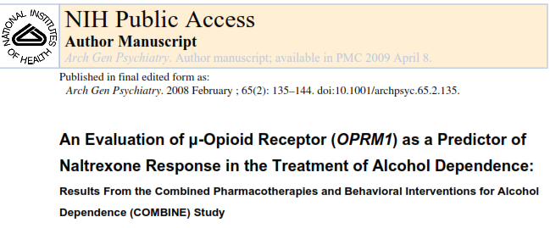

Slide 47
Other
Treating co-occurring disorders – can it help preserve or increase abstinence based recovery?
Stimulants for ADHD
Benzos or Opiates for RLS
Pain meds for chronic pain
Benzos for severe anxiety disorders

Slide 48
Maintenance Therapy
Buprenorphine
Methadone
Nicotine

